Slide 1
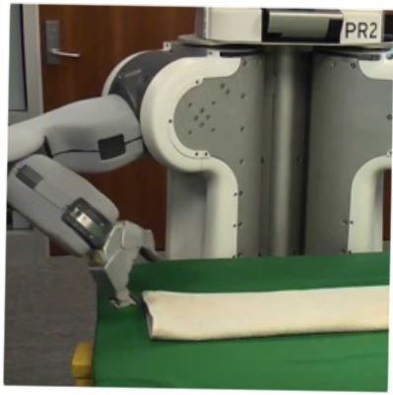
Programming by Examples
Sumit Gulwani
Microsoft
ECML/PKDD Conference
Sep 2019

Slide 2
Example-based help-forum interaction
300_w30_aniSh_c1_b → w30
300_w5_aniSh_c1_b → w5
=MID(B1,5,2)
=MID(B1,5,2)
=MID(B1,FIND(“_”,$B:$B)+1, FIND(“_”,REPLACE($B:$B,1,FIND(“_”,$B:$B),””))-1)

Slide 3
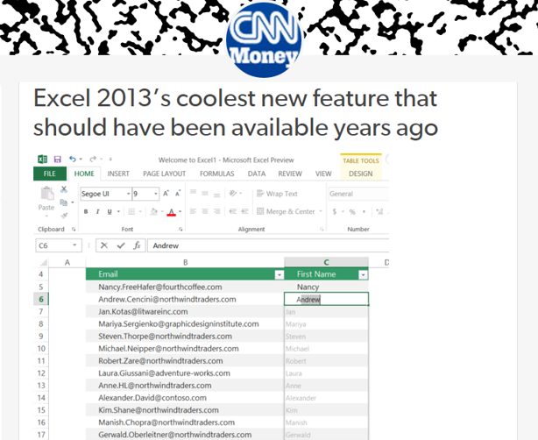
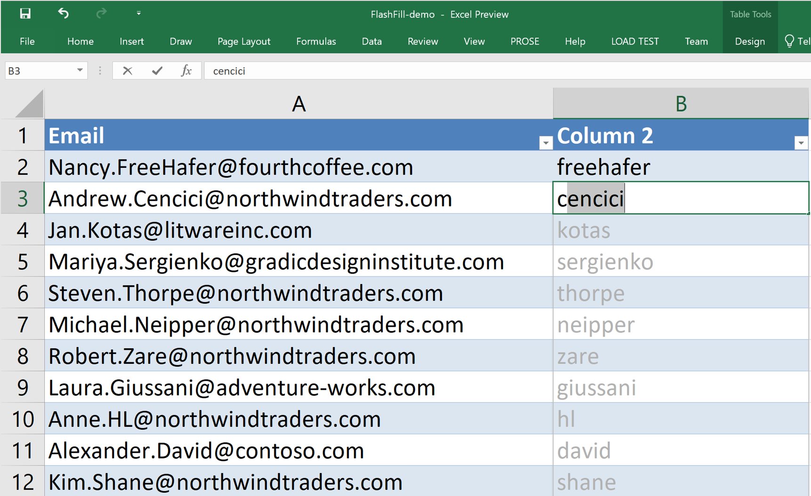
Flash Fill (Excel feature)
Excel 2013’s coolest new feature that
should have been available years ago
“Automating string processing in spreadsheets using input-output examples”
[POPL 2011] Sumit Gulwani

Slide 4
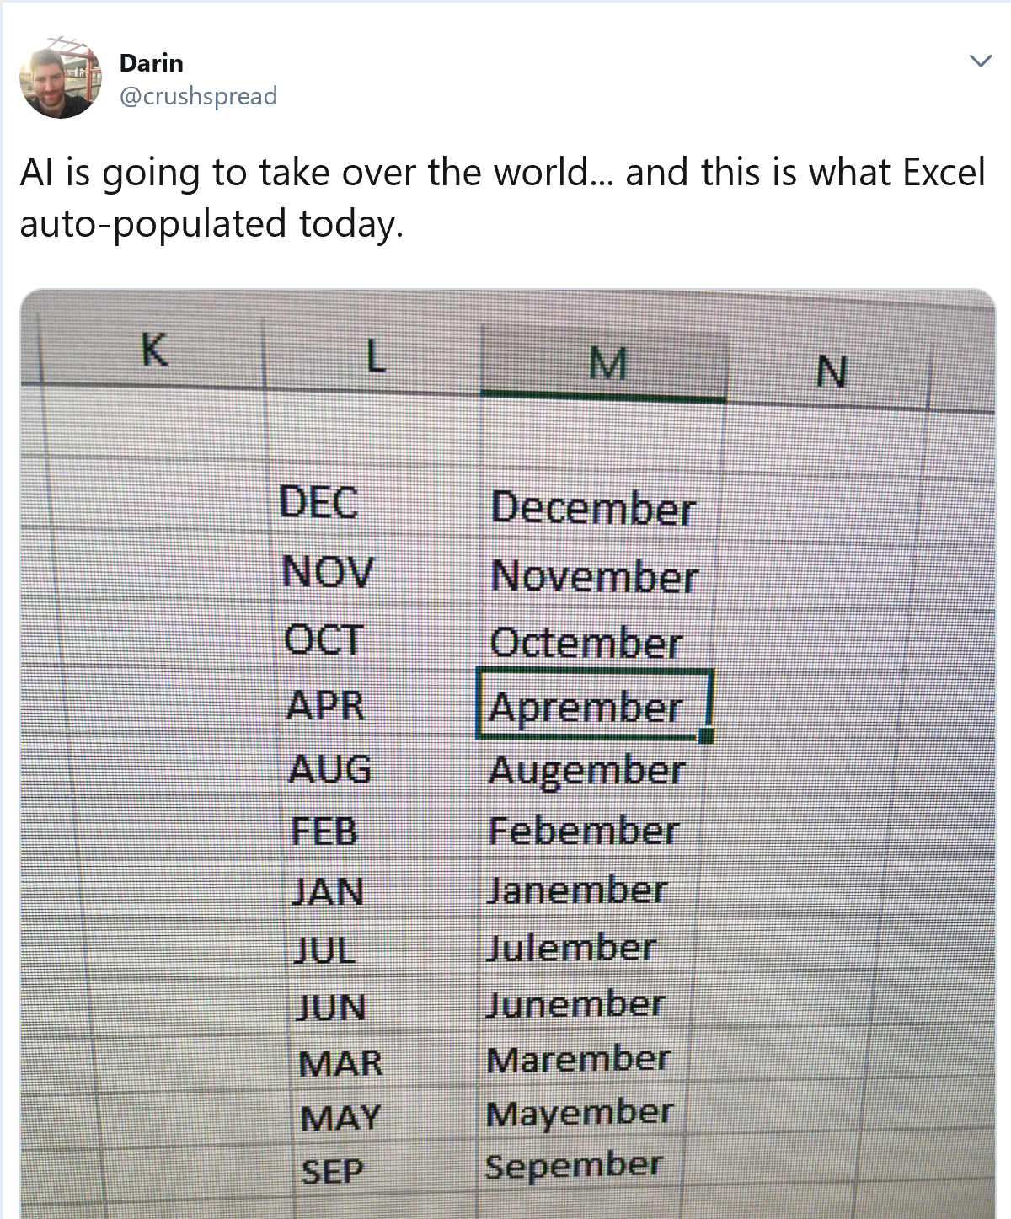

Slide 5
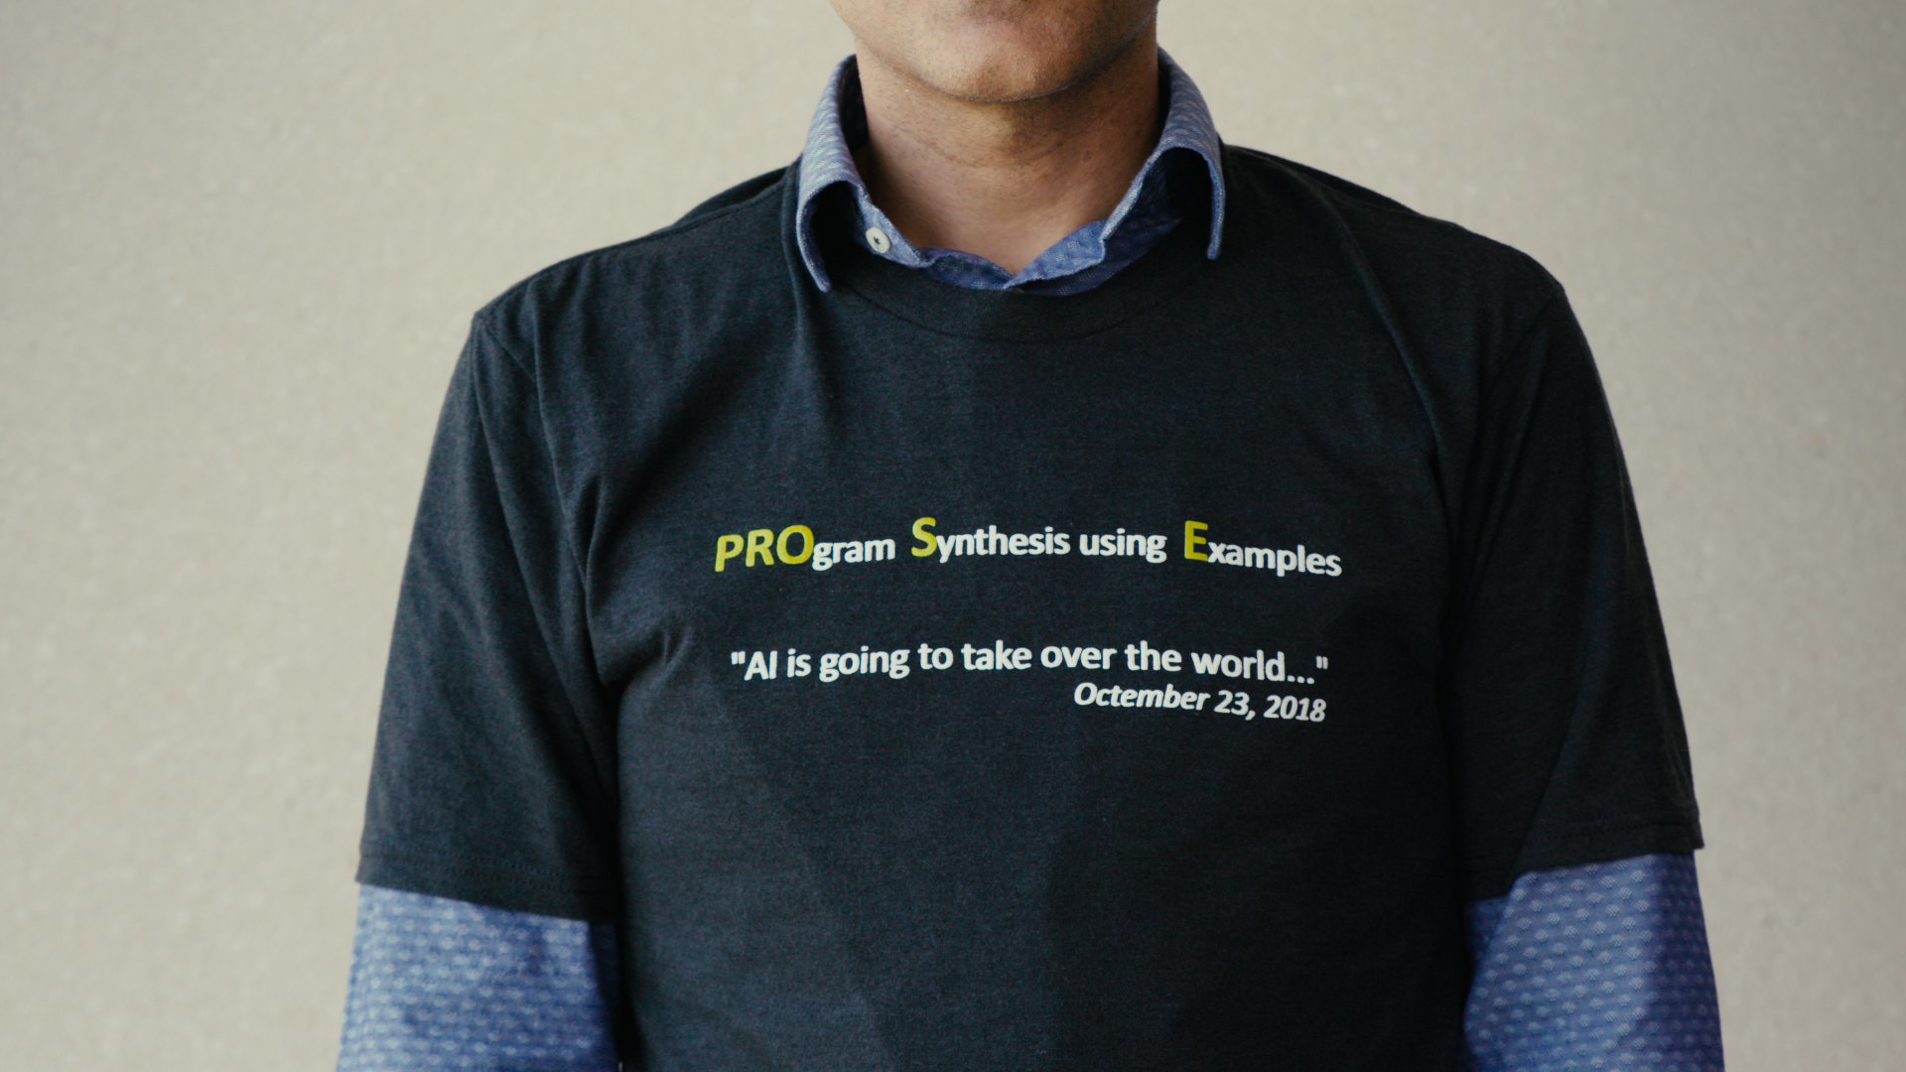

Slide 7
Number, DateTime Transformations
Input | Output (round to 2 decimal places)
123.4567 | 123.46
123.4 | 123.40
78.234 | 78.23
Excel/C#:
Python/C:
Java:
#.00
.2f
#.##
Input | Output (3-hour weekday bucket)
CEDAR AVE & COTTAGE AVE; HORSHAM; 2015-12-11 @ 13:34:52; | Fri, 12PM - 3PM
RT202 PKWY; MONTGOMERY; 2016-01-13 @ 09:05:41-Station:STA18; | Wed, 9AM - 12PM
; UPPER GWYNEDD; 2015-12-11 @ 21:11:18; | Fri, 9PM - 12AM
[CAV 2012] “Synthesizing Number Transformations from Input-Output Examples”; Singh, Gulwani
[POPL 2015] “Transforming Spreadsheet data types using Examples”; Singh, Gulwani

Slide 8
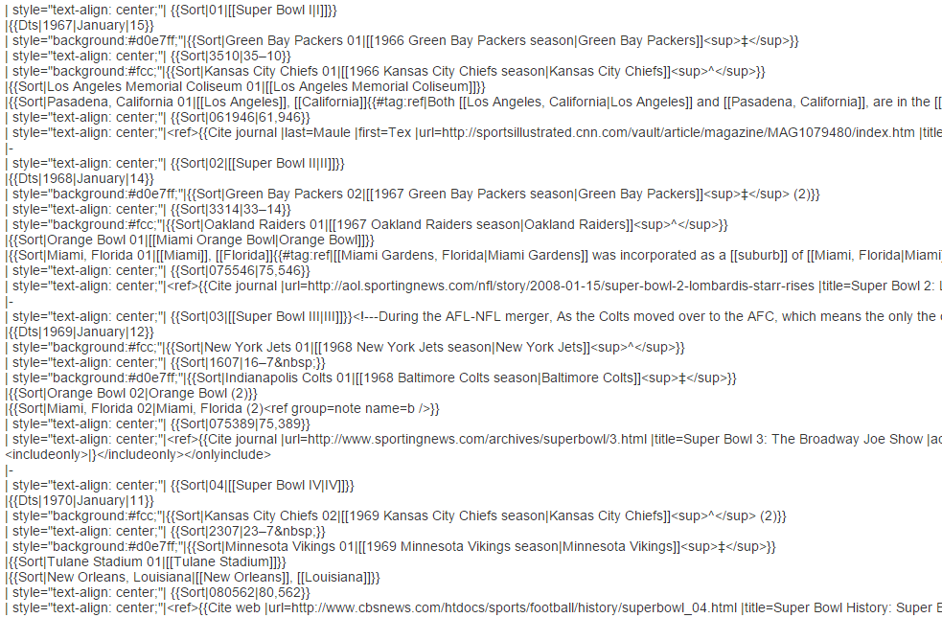
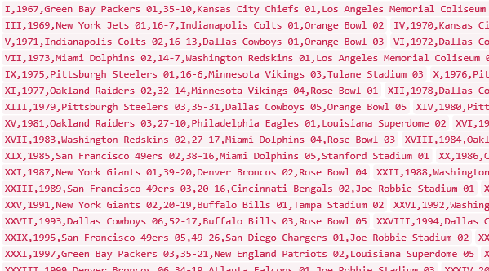
Table Extraction
“FlashExtract: A Framework for data extraction by examples”
[PLDI 2014] Vu Le, Sumit Gulwani

Slide 9
Table Reshaping
Bureau of I.A.
Regional Dir. | Numbers
Niles C. | Tel: (800)645-8397
 | Fax: (907)586-7252
Jean H. | Tel: (918)781-4600
 | Fax: (918)781-4604
Frank K. | Tel: (615)564-6500
 | Fax: (615)564-6701
 | Tel | Fax
Niles C. | (800)645-8397 | (907)586-7252
Jean H. | (918)781-4600 | (918)781-4604
Frank K. | (615)564-6500 | (615)564-6701
FlashRelate
From few examples of rows in output table
50% spreadsheets are semi-structured.
KPMG, Deloitte budget millions of dollars for normalization.
“FlashRelate: Extracting Relational Data from Semi-Structured Spreadsheets Using Examples”
[PLDI 2015] Dan Barowy, Sumit Gulwani, Ted Hart, Ben Zorn

Slide 10
PBE Architecture
Examples
Search Engine
DSL D
Examples
Program
set
Intended Program
(in D)
Ranked
Program set
Program Ranker
Disambiguator
Huge search space
Prune using Logical reasoning
Guide using Machine learning
Test inputs
Under-specification
Guess using Ranking (PL features, ML models)
Interact: leverage extra inputs (clustering) and programs (execution)
“Programming by Examples: PL meets ML”
[APLAS 2017] Sumit Gulwani, Prateek Jain

Slide 11
Flash Fill DSL
$$Tuple\left(String x_{1},…,String x_{n}\right)→ String$$
top-level expr $T$ := $C$ | $ifThenElse(B,C,T)$
condition-free expr $C$ := $A$ |
atomic expression $A$ :=
input string $X$ := $x1 | x2 | …$
position expression $P$ :=$K$| $Pos(X, R1, R2, K)$
$$Concat(A,C)$$
$$SubStr(X, P,P)$$
$$| ConstantString$$
K^{th} position in X whose left/right side matches with R₁/R₂.
“Automating string processing in spreadsheets using input-output examples”
[POPL 2011] Sumit Gulwani

Slide 12
Search Idea 1: Deduction
Let $\left[G⊨φ\right]$ denote programs in grammar G that satisfy spec $φ$
$φ$is a Boolean constraint over (input state $i⇝$output value $o$)
Divide-and-conquer style problem reduction
$$\left[G⊨φ_{1}∧φ_{2}\right]=Intersect\left(\left[G⊨φ_{1}],[G⊨φ_{2}\right]\right)$$
$=\left[G_{1}⊨φ_{2}\right]$ where $G_{1}=[G⊨φ_{1}]$
Let $G≔G_{1} | G_{2}$
$\left[G⊨φ\right]=$ $\left[G_{1}⊨φ\right] | \left[G_{2}⊨φ\right]$
“FlashMeta: A Framework for Inductive Program Synthesis”
[OOPSLA 2015] Alex Polozov, Sumit Gulwani

Slide 13
Search Idea 1: Deduction
Inverse Set: $F^{−1}\left(o\right)≝\left\{ \left(u,v\right) \right| F\left(u,v\right)=o \}$
E.g. $Concat^{−1}\left(\text{"}\text{Abc}"\right)=\{ \left("A", "bc"\right), (\text{"}\text{Ab}\text{"}, "\text{c}\text{"}), …\}$
Let $G ≔F\left(G_{1},G_{2}\right)$
Let $F^{−1}\left(o\right)$be $\{ \left(u,v\right), \left(u^{′},v^{′}\right)\}$
$\left[G⊨(i⇝o)\right]=$ $F\left(\left[G_{1}⊨\left(i⇝u\right)\right],\left[G_{2}⊨\left(i⇝v\right)\right]\right)$
\ $F\left(\left[G_{1}⊨\left(i⇝u′\right)\right],\left[G_{2}⊨\left(i⇝v′\right)\right]\right)$
$$\left[G⊨(i⇝o)\right]=$$
“FlashMeta: A Framework for Inductive Program Synthesis”
[OOPSLA 2015] Alex Polozov, Sumit Gulwani

Slide 14
Search Idea 2: Learning
Machine Learning for ordering search
Which grammar production to try first?
Which sub-goal resulting from inverse semantics to try first?
Prediction based on supervised training
standard LSTM architecture
Training: 100s of tasks, 1 task yields 1000s of sub-problems.
Results: Up to 20x speedup with average speedup of 1.67
“Neural-guided Deductive Search for Real-Time Program Synthesis from Examples”
[ICLR 2018] Mohta, Kalyan, Polozov, Batra, Gulwani, Jain

Slide 15
Ranking Idea 1: Program Features
Input | Output
Vasu Singh | v.s.
Stuart Russell | s.r.
P1: Lower(1st char) + “.s.”
P2: Lower(1st char) + “.” + 3rd char + “.”
P3: Lower(1st char) + “.” + Lower(1st char after space) + “.”
Prefer programs (P3) with simpler Kolmogorov complexity
Fewer constants
Smaller constants
“Predicting a correct program in Programming by Example”
[CAV 2015] Rishabh Singh, Sumit Gulwani

Slide 16
Ranking Idea 2: Output Features
Input | Output
[CPT-123 | [CPT-123]
[CPT-456] | [CPT-456]
Output of P1
[CPT-123]
[CPT-456]]
P1: Input + “]”
P2: Prefix of input upto 1st number + “]”
Examine features of outputs of a program on extra inputs:
IsYear, Numeric Deviation, # of characters, IsPerson
“Learning to Learn Programs from Examples: Going Beyond Program Structure”
[IJCAI 2017] Kevin Ellis, Sumit Gulwani

Slide 17
Disambiguation
Communicate actionable information back to user.
Program-based disambiguation
Enable effective navigation between top-ranked programs.
Highlight ambiguity based on distinguishing inputs.
Heuristics that can be machine learned
Highlight ambiguity based on clustering of inputs/outputs.
When to stop highlighting ambiguity?
[UIST '15] “User Interaction Models for Disambiguation in Programming by Example”
[OOPSLA ‘18] “FlashProfile: A Framework for Synthesizing Data Profiles”

Slide 18
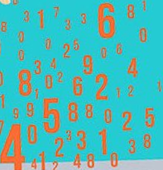
ML in PBE
PBE Component
Logical strategies
Creative heuristics
Features
+
Model
+
Advantages
Better models
Less time to author
Online adaptation, personalization
Can be learned and maintained by ML-backed runtime
Written by developers
“Programming by Examples: PL meets ML”
[APLAS 2017] Sumit Gulwani, Prateek Jain

Slide 19
Mode-less Synthesis
Non-intrusively watch, learn, and make suggestions
Advantages: Usability, Avoids Discoverability
Applications: Document Editing, Code Refactoring, Robotic Process Automation
Key Idea: Identify related examples within noisy action traces
“On the Fly Synthesis of Edit Suggestions”
[OOPSLA 2019] Miltner, Gulwani, Le, Luang, Radhakrishna, Soares, Tiwari, Udupa

Slide 20
Predictive Synthesis
Synthesis of intended programs from just the input.
Predictive Synthesis : PBE :: Unsupervised : Supervised ML
Applications: Tabular data extraction, Join, Sort, Split
Key Idea: Structure inference over inputs
“Automated Data Extraction using Predictive Program Synthesis”
[AAAI 2017] Mohammad Raza, Sumit Gulwani

Slide 21
Synthesis of Readable Code
Synthesis in target language of choice.
Python, R, Scala, PySpark
Advantages:
Transparency
Education
Integration with existing workflows in IDEs, Notebooks
Challenges: Quantify readability, Quantitative PBE
Key Idea: Observationally-equivalent (but non-semantic preserving) transformation of an intended program

Slide 22
Program Synthesis meets Notebooks
A match made in heaven!
PS can synthesize small code fragments. Sufficient for notebook cell-based programming.
PS can synthesize code in different languages.
A good solution for polyglot challenge in notebooks.
PS needs interactivity. Notebooks provide that.

Slide 23
Other Topics in Program Synthesis
Search methodology: Code repositories [Murali et.al., ICLR 2018]
Language: Neural program induction
[Graves et al., 2014; Reed & De Freitas, 2016; Zaremba et al., 2016]
Intent specification:
Natural language [Huang et.al., NAACL-HLT 2018; Gulwani, Marron SIGMOD 2014, Shin et al. NeurIPS 2019]
Conversational pair programming
Applications:
Super-optimization for model training/inference
Personalized Learning [Gulwani; CACM 2014]

Slide 24
Conclusion
Program Synthesis: key to next-generational programming
Future: Multi-modal programming with Examples and NL
100x more programmers
10-100x productivity increase in several domains.
Next-generational AI techniques under the hood
Logical Reasoning + Machine Learning
Questions/Feedback: Contact me at sumitg@microsoft.com

